Slide 1

PROCESS MINING VIRTUAL INTERNSHIP
by
U GANESH
224G5A3202
Department of Computer Science and Engineering (Data Science)
Srinivasa Ramanujan Institute of Technology
(Affiliated to JNTUA & Approved by AICTE) (Accredited by NAAC with ‘A’ Grade & Accredited by NBA (EEE, ECE & CSE)
Rotarypuram Village, B K Samudram Mandal, Ananthapuramu – 515701.
2023 - 2024

Slide 2

Contents
Course Objective
Introduction
Technology
Applications
Modules
Real Time applications
Learning outcomes
GitHub Link
Queries

Slide 3
Course objective
Participants will gain a comprehensive understanding of process mining's versatile applications across industries.
They will learn how process mining extracts insights from event data, optimizing workflows. Real-world examples will highlight its role in boosting efficiency, compliance, and decision-making in organizations.
The course introduces core process mining concepts - event logs, process models, and data quality. Participants gain practical experience using industry-standard tools, enhancing their ability to analyze real data and bridge theory with practice.

Slide 4
Introduction
Process mining is a set of techniques for the analysis of operational processes based on event logs extracted from company’s databases, information systems, or business management software
Process mining consists of two important aspects. An event refers to a case or, an activity and Logs are additional information about events
. Process Discovery identifies the business processes, maps and analyzes an organization’s existing business processes, uncovers the process steps that they are not aware of, and realizes process deviations.

Slide 5
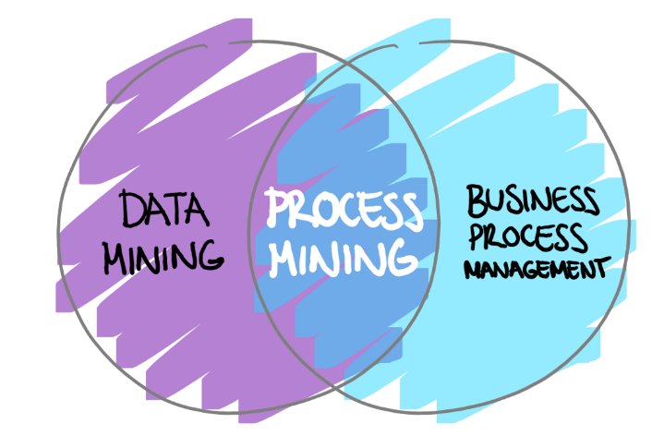
Introduction
Process Discovery identifies the business processes, maps and analyzes an organization’s existing business processes, uncovers the process steps that they are not aware of, and realizes process deviations.

Slide 6
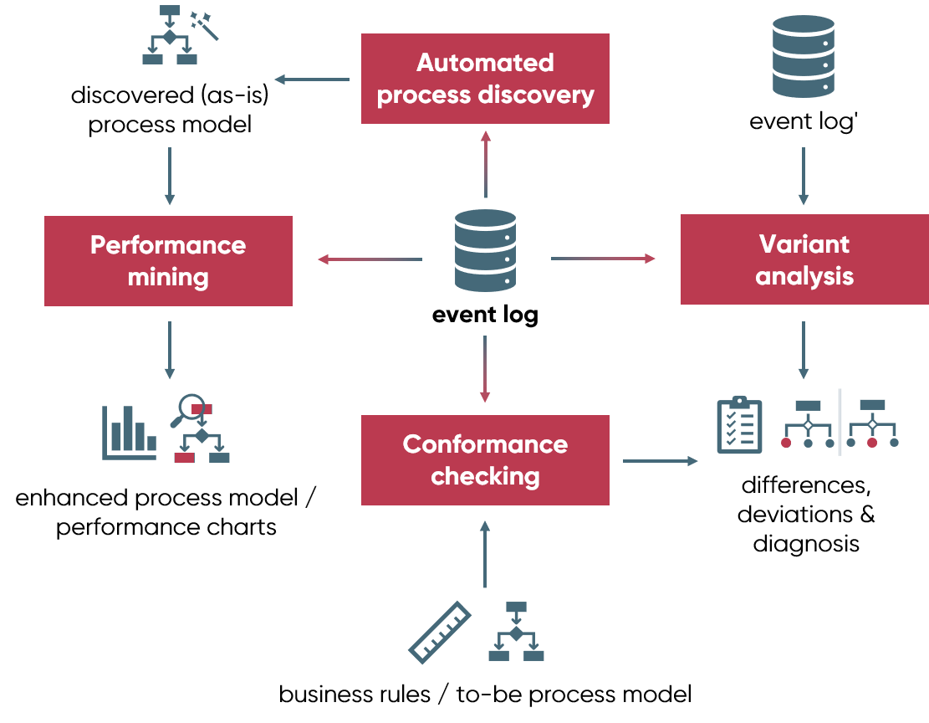
Technology
Process mining is a data science technique that involves using data mining and process analytics to uncover, validate, and enhance workflows within organizations
Process mining is a technique to analyze and
track processes.
In traditional business process management,
it is done with process workshops and
interviews, which results in an idealized
picture of a process.

Slide 7
Technology
(Automated) Process discovery is a primary technique and implies extracting and visualizing process models from an event.
Conformance checking compares the actual process with a predefined model to discover deviations. So, it’s used to check if the reality conforms to an existing pattern.
Enhancement goes beyond measuring and comparing. It’s focused on extending the model with additional information, such as location data, costs, timing, etc. Enhancing the model with such attributes helps improve its performance and conduct more advanced analysis.

Slide 8
Applications
Process Discovery for Automation:
Automation provides faster and lower-cost solutions. However, companies need to examine their business processes to use automation tools, such as robotic process automation (RPA) efficiently. Process mining vendors claim that their technology can reduce automation implementation time by 50%.
Financial Services:
In the world of finance and business,a ton of transactions are happening online, process mining is like having a super detective that makes sure everything is going smoothly and follows the rules. This is really helpful because rules and regulations are getting more strict, and companies need to show that they're playing by the rules.

Slide 9
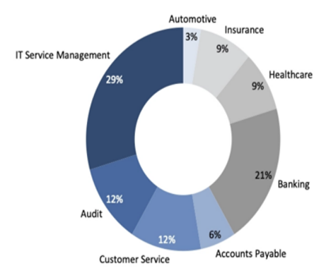
Applications
IT Systems Analysis:
Process mining can be used
to understand how different software
applications are interacting within a
company's IT system. This can help
in troubleshooting and optimizing IT
processes.

Slide 10
Modules
Data Extraction: This is the first step in process mining. Data is collected from various sources, such as IT systems, databases, and logs. This data includes information about the activities, timestamps, users, and other relevant details of the process being analyzed.
Preprocessing and Data Transformation: Raw data is often messy and complex. In this module, the data is cleaned, organized, and transformed into a suitable format for analysis. Irrelevant or incomplete data is removed, and the remaining data is structured to prepare it for further processing.
Process Discovery: This module is the heart of process mining. It involves creating a visual representation of the process flow based on the collected data. This representation is often in the form of process maps, flowcharts, or graphs that show how different activities are connected and the sequence in which they occur.

Slide 11
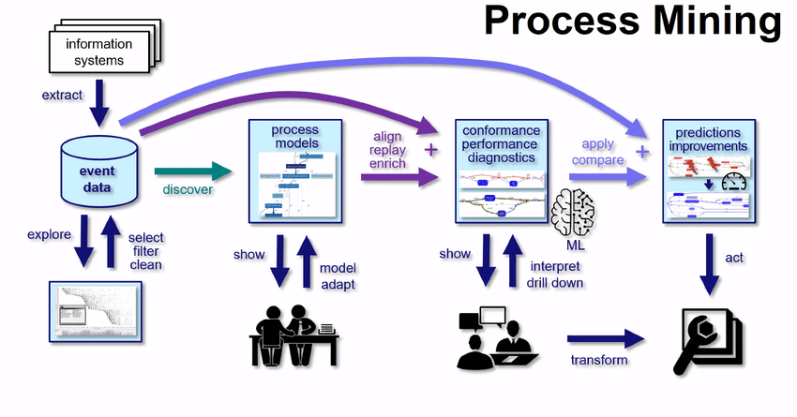
Modules
Conformation Checking:
After the process is discovered, this module compares the actual process as recorded in the data with the expected or ideal process. Anydeviations, anomalies, or non-compliance with predefined rules or benchmarksare highlighted. This helps organizations identify areas where the process isn't being followed correctly.

Slide 12
Real Time Applications
Supply Chain Management: In logistics and manufacturing, process mining can track the movement of goods in real time, helping identify delays, optimize routes, and ensure timely deliveries.
Healthcare Workflow Optimization: Process mining can be used to monitor patient flows in hospitals, clinics, and healthcare systems. It helps identify bottlenecks, streamline patient care, and ensure efficient resource allocation.
IT Incident Management: In the IT sector, process mining can analyze real-time data from systems and applications to quickly detect and resolve incidents, reducing downtime and maintaining smooth operations.

Slide 13
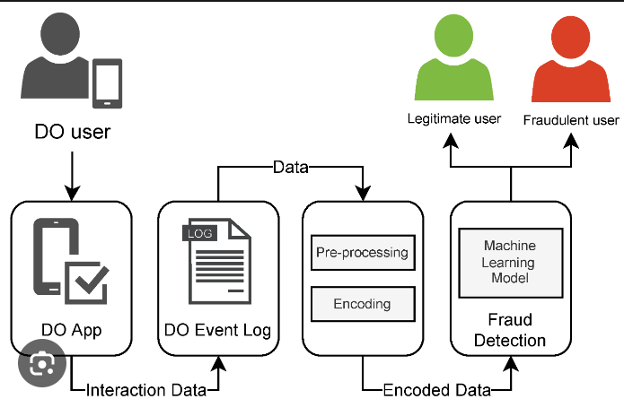
Real Time Applications
Fraud Detection and Prevention: Financial institutions can use process mining to monitor transactions in real time, flagging unusual patterns or behaviors that might indicate fraudulent activities.

Slide 14
Learning Outcomes
Interpret process visualizations and leverage analyses to identify process inefficiencies.
Conceptualize your process in terms of activities and cases.
Able to understand the basics of the technology
Understood the real time applications of the process mining
Save an analysis selection for future reference and share it with your team; export visualizations and process data.

Slide 15
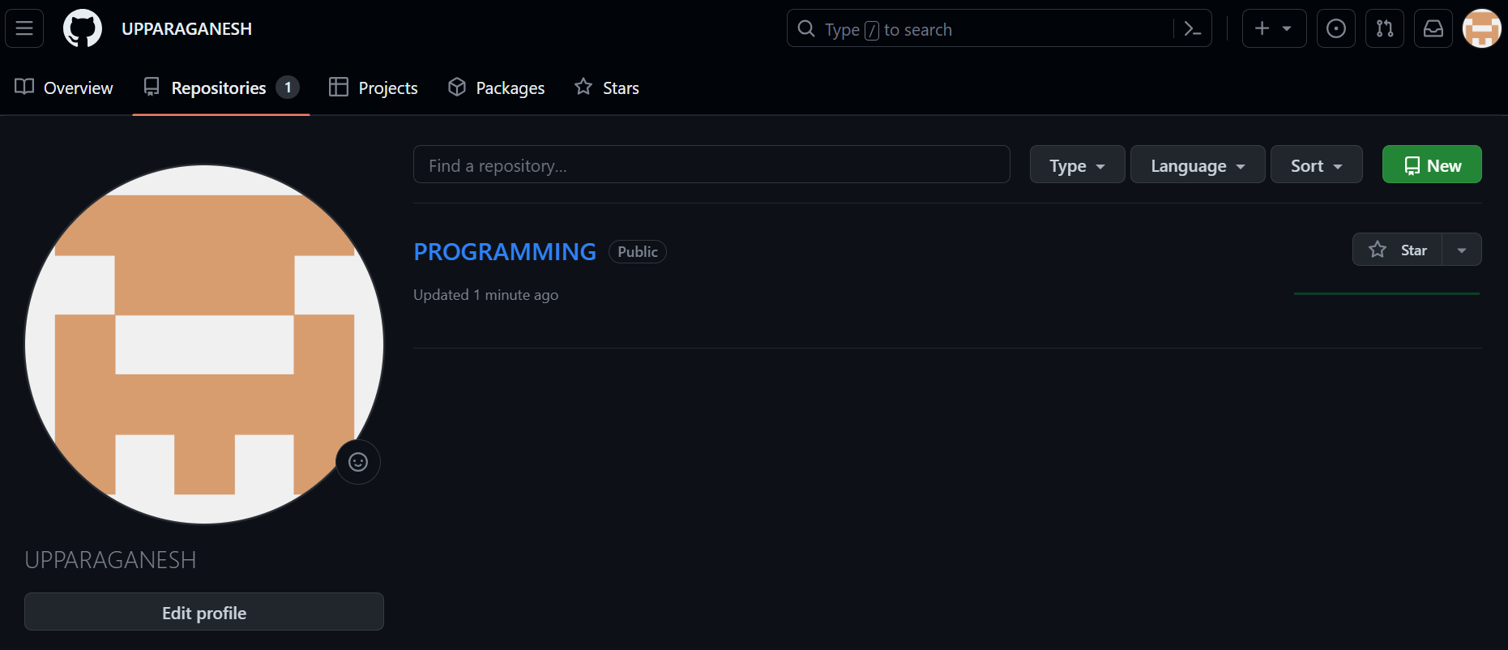

Git Hub Dashboard
GitHub Link : https://github.com/UPPARAGANESH

Slide 16
Any Queries?

Slide 17
Thank You!!!

